Slide 1

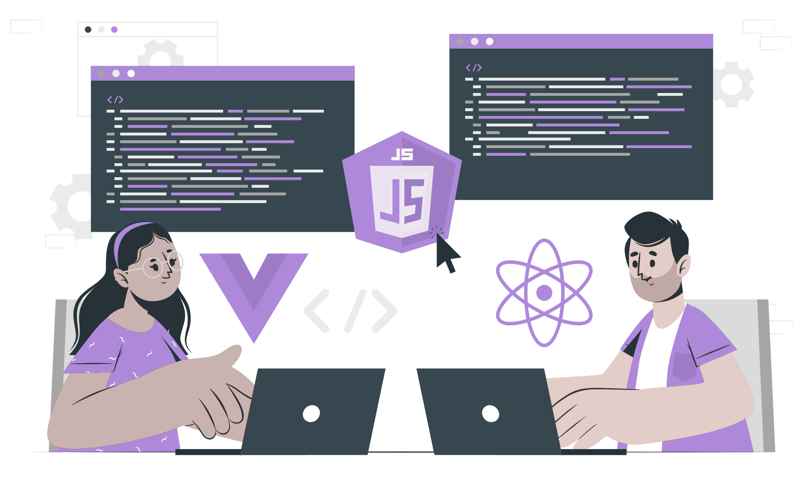
Different types of Node.js Frameworks

Slide 2
Topics
What are Frameworks
What are the different types of Node.js Frameworks

Slide 3
What are Frameworks
A framework is a software tool or platform that provides developers with a set of pre-written code, components, and libraries that they can use to build applications.
Frameworks often include a set of guidelines and best practices that help developers to write code more efficiently and to build applications that are more stable, secure, and scalable.
Some popular web development frameworks include Ruby on Rails, Django, Laravel, React, Angular, and Vue.js.
Frameworks can vary in complexity and size, from lightweight micro-frameworks that provide only the bare essentials, to full-stack frameworks that include everything from front-end libraries to back-end database integration.

Slide 4
What are the different types of Node.js Framework
Some of the different types of Node.js Frameworks that help software architects to develop applications efficiently and with ease are as follows -
Express.js
Koa.js
Nest.js
Hapi.js
Fastify.js
Sails.js

Slide 5
THANK YOU

